Slide 1

CROWD Density estimation
EE528 – Deep learning for video surveillance systems
Jayesh Gupta(1701EE16)
Raman Karhad(1701EE17)

Slide 2
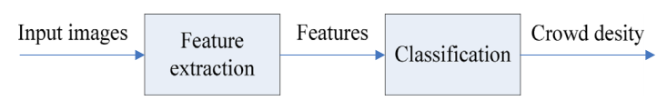
Why crowd density estimation ?
Nowadays intelligent surveillance has been widely used in fire detection, vehicle identification, crowd management and so on.
Crowd density estimation which is a crucial part of crowd management has become more and more important for managing of possible stampedes.
In general, to estimate the crowd density, crowd features need to be designed first and then a classifier needs to be trained to discriminate the crowd density by these features.

Slide 3
Possible approaches
Image Processing –
Stationary crowd : Background removal and edge detection.
Moving crowd : Optical flow computation. However, they are at a disadvantage when crowd density is high.
Support Vector Machines, Decision Trees etc. However their accuracy for practical applications are not good.
Neural Networks, in particular Convolutional Neural Network, for being similar in discrimination to human neuron, and also for shift, scale and distortion invariance.

Slide 4
Reference paper
Fast crowd density estimation with convolutional neural networks
Min Fu, Pei Xu, Xudong Li, Qihe Liu, Mao Ye, Ce Zhu
Engineering Applications of Artificial Intelligence
Vol 43 (2015), 81 – 88.

Slide 5
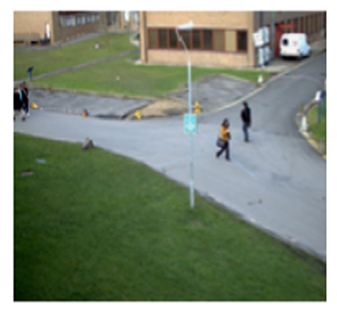
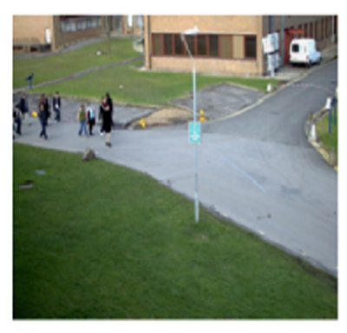
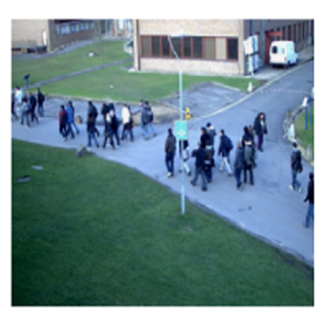
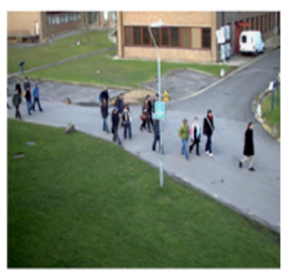
DATASET
PETS(Performance Evaluation of Tracking and Surveillance) 2009, S1 : Person count and density estimation was used. It contains video sequences of people crossing the street.
Video sequences were broken in frames with total frames being 640. Half was used for training and the other half for testing.
Class labels were manually generated according to the following criteria.
0 – 8 : Very Low
9 – 16: Low
17 – 24 : Medium
25 – 32 : High
≥ 33 : Very High

Slide 6
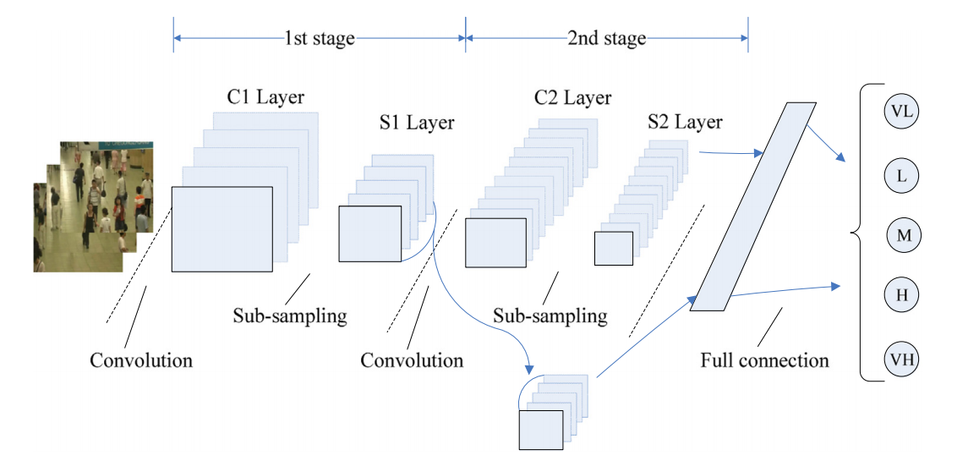
Structure of multistage cnn

Slide 7


Optimizing connections
Multistage CNN increases the features – remove redundant connections!
Once the similarity between two maps is confirmed to satisfy the condition, one of them is randomly chosen to be deleted together with the connections.
The weights of the connections from the deleted map are added up to the kept ones before being removed.
Similarity matrix M is derived by,
where N is the total number of samples, and M_{k} is the similarity measure for one sample, which is given by cosine similarity between the map A_{i} and A_{j} ,

Slide 8
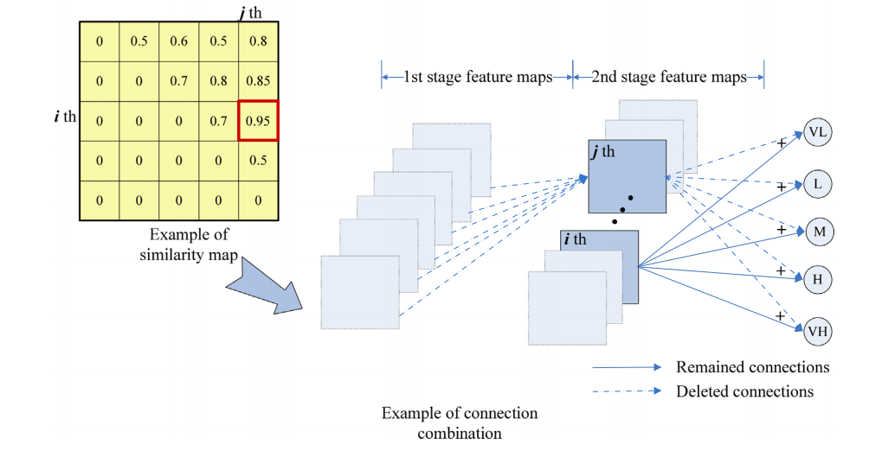
Optimizing connections

Slide 9
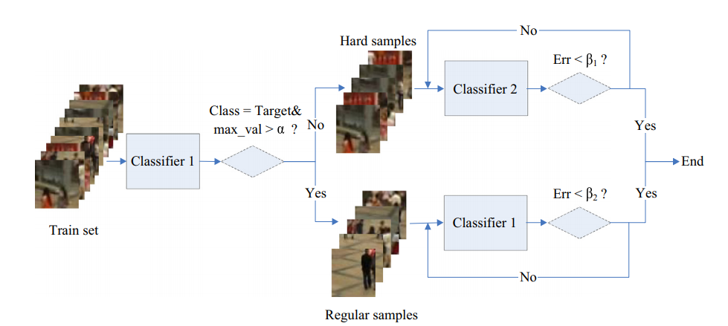
Cascade classifier
Samples which have complicated background are hard to fit, making it hard for the network to converge.
The idea is to divide the training set in two portions for the two classifiers, one corresponding to easy fit and other to hard fit.

Slide 10
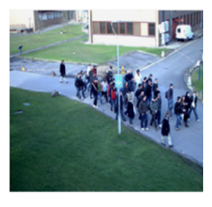
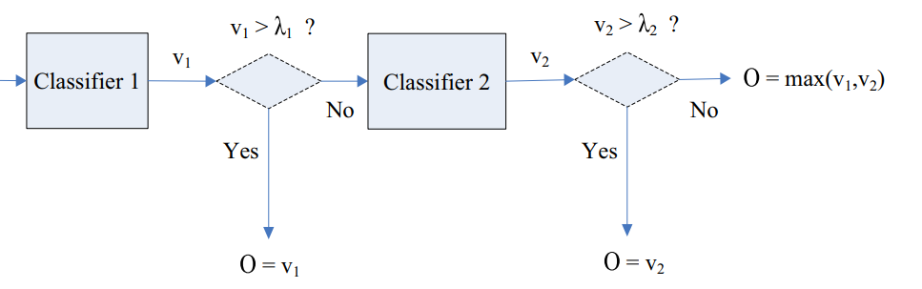
Prediction procedure
For prediction, we make use of our cascade classifier.
Let v₁ and v₂ be the max value generated by the two classifiers. Then,
Here, λ₁ = 0.7 and λ₂ = 0.5.

Slide 11
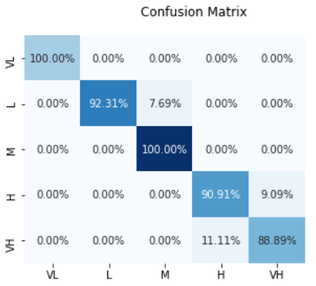
Results
The model produced an accuracy of 94.60% as compared to 96.04% mentioned in the paper.
The accuracy however fluctuated , revolving around 89 – 95%.
Our custom model, however produced a lower accuracy of 85% (tuning in process),

Slide 12
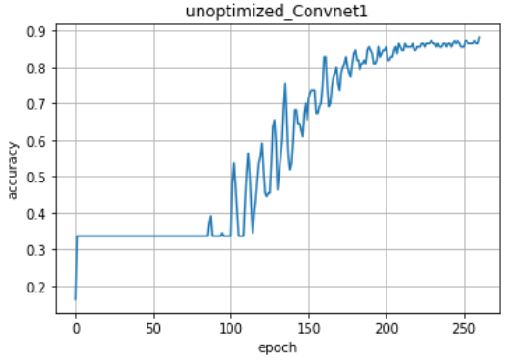
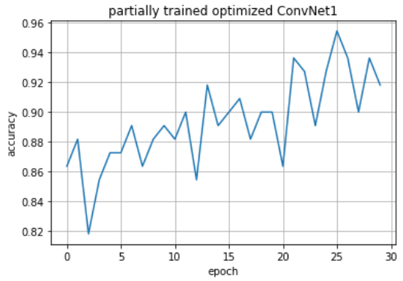
Remarks
During training at different stages, a lot of oscillation was observed in ‘accuracy’ vs ‘epoch’ curve.

